Slide 1
Portals
3WEBD

Slide 2
3WEBD – Portals
Course Objectives
By the end of the course, students should:
Have a better understanding of the DOM
Know when to use a Portal
Capable to implement a Portal
Time:
course: 1h
exercises: 2h

Slide 3
Summary
DOM and vDOM
Portals
Fragments

Slide 4
1. DOM and vDOM

Slide 5
1. DOM and vDOM
The DOM is a programming interface provided by the browser, allowing scripts to dynamically access and update the content, structure, and style of a document.
Essentially, the DOM represents the HTML document as a tree of nodes, where each node corresponds to a part of the document (elements, attributes, text, etc.).
When you interact with a webpage (e.g., clicking a button, submitting a form), the DOM is updated to reflect these changes.

Slide 6
1. DOM and vDOM
However, direct and frequent manipulations of the DOM can be slow and inefficient.
This is because every change to the DOM can trigger reflows and repaints, where the browser recalculates element positions and redraws them on the screen.
For complex applications with frequent updates, this can lead to noticeable performance issues.

Slide 7
1. DOM and vDOM
React introduces the concept of the Virtual DOM to address the performance drawbacks of direct DOM manipulation.
The Virtual DOM is a lightweight, in-memory representation of the real DOM elements.
It's essentially a copy of the DOM but without the overhead of being directly tied to the document displayed in the browser.

Slide 8
1. DOM and vDOM
Using the vDOM and not the DOM is a choice done by React to greatly improve performance.
Other framework used other concept to not directly handle the DOM and work with some representations of the DOM.

Slide 9
1. DOM and vDOM
Performance Improvements: By minimizing direct DOM manipulations and batching updates, React ensures that the user interface remains fast and responsive, even with frequent updates.

Slide 10
1. DOM and vDOM
Declarative UI: Developers describe what the UI should look like for any given state, and React takes care of updating the DOM to match. This declarative model simplifies the development process and makes the code more predictable and easier to debug.

Slide 11
1. DOM and vDOM
Efficient Updates: The diffing algorithm allows React to update only what's necessary, rather than re-rendering the entire component tree. This selective rendering avoids unnecessary work and improves application performance.

Slide 12
1. DOM and vDOM
Working with a virtual DOM is completely hidden by React, you are not even really aware of it except when you look for it.
React handles the UI part of the framework thanks to it and this work in multiple steps.

Slide 13
1. DOM and vDOM
1. Initial Rendering: React creates a Virtual DOM tree that corresponds to the actual DOM.
The virtual DOM is a representation of the UI saved in memory. It's a node tree that lists the elements, their attributes, and content as objects and properties.

Slide 14
1. DOM and vDOM
2. State Changes/Updates: When the state of a React component changes (due to user interactions, data fetches, etc.), React creates a new Virtual DOM tree that reflects those changes.

Slide 15
1. DOM and vDOM
3. Diffing Algorithm: React compares the new Virtual DOM tree with the previous one using a diffing algorithm. This process identifies exactly which virtual DOM objects have changed, down to the individual elements and attributes.

Slide 16
1. DOM and vDOM
4. Batch Updates: Once the differences are calculated, React updates the real DOM only where those changes occurred. This minimizes direct DOM manipulations, reflows, and repaints.

Slide 17
1. DOM and vDOM
5. Reconciliation: This entire process of creating a Virtual DOM, diffing it with the previous version, and updating the real DOM as needed is known as reconciliation.

Slide 18
1. DOM and vDOM
The Virtual DOM is a core part of React's architecture, allowing for efficient updates and rendering of the user interface by serving as an intermediate step between the application's state and the actual DOM.
This approach to UI rendering and updates is what makes React so powerful and popular for developing dynamic web applications.

Slide 19
1. DOM and vDOM
While the virtual DOM offers significant advantages, it's not without its limitations.
For example, the initial creation of the virtual DOM and the diffing process can add overhead, especially for very large and complex UIs.
However, for most applications, this overhead is offset by the performance gains during updates.

Slide 20
1. DOM and vDOM
The virtual DOM is a core technology behind the efficiency of modern JavaScript frameworks and libraries, enabling fast and seamless user experiences even in complex applications.
By abstracting away direct DOM manipulation, it allows developers to build highly interactive and dynamic web applications more easily and efficiently.

Slide 21

Exercises

Slide 22
2. Portals

Slide 23
2. Portals
A Portal provides a first-class way to render children into a DOM node that exists outside the DOM hierarchy of the parent component.
This feature is particularly useful for when you need to break out of the parent container to render modals, dialogs, or tooltips that need to visually "break out" of their container, for example, to cover the entire screen or to float independently of the parent positioning.

Slide 24
2. Portals
Portals are useful in scenarios where the parent component has overflow: hidden or z-index styling, but you need the child to visually "break out" of its container.
Without portals, you'd have to manage complex state or pass callbacks up and down the component tree to render the child in the desired location. Portals simplify this process.

Slide 25
2. Portals
There is a fey keypoint to be aware of when working with Portals
Event Bubbling: An important feature of portals is that, even though the portal can be anywhere in the DOM tree, it behaves like a normal React child in every other way.
This means events bubble up through the portal, regardless of where it is in the DOM tree.

Slide 26
2. Portals
Usage with Hooks: Portals work seamlessly with functional components and class components.
You might often see them used with hooks, particularly for managing the display of modals or toasts.

Slide 27
2. Portals
Accessibility Considerations: When using portals for modal dialogs, it's important to manage focus and ensure that screen readers correctly announce the page's content.
React doesn't include built-in functionality for this, so you need to manage it manually, ensuring a good user experience for keyboard and screen reader users.

Slide 28
2. Portals
Portals offer a powerful pattern for component rendering and provide an elegant solution to common UI challenges in React applications, enhancing flexibility without sacrificing the benefits of the React component model.
So how do we use them?

Slide 29
2. Portals
We'll create a simple modal component that renders its children into a div appended directly to the body element, ensuring it's not affected by the CSS of its parent components.

Slide 30
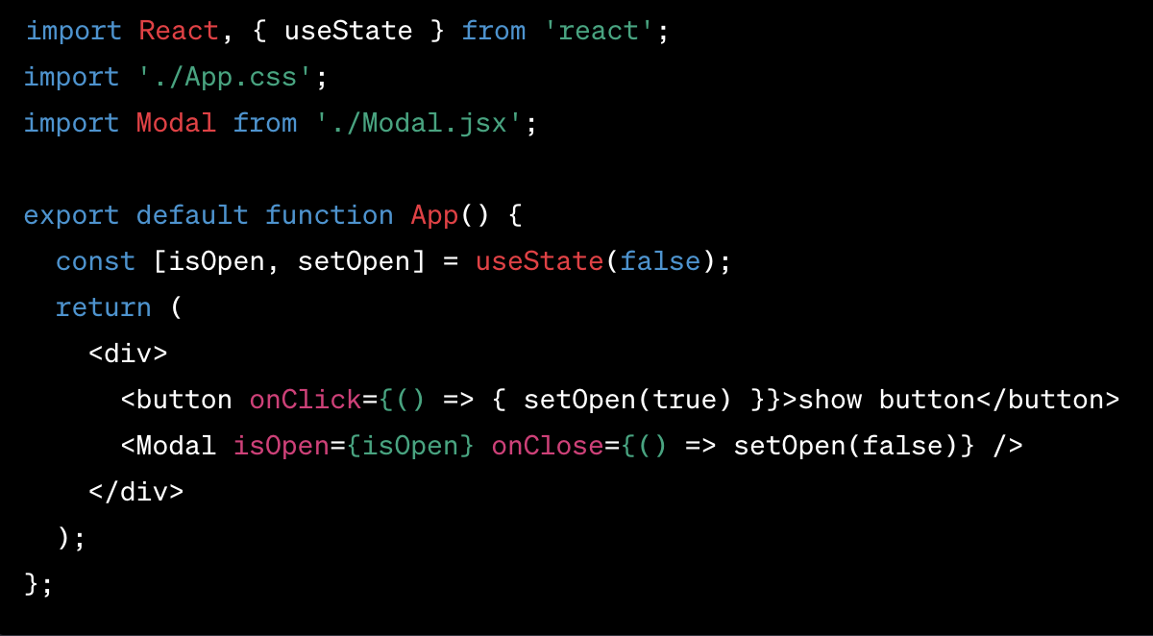
2. Portals

Slide 31
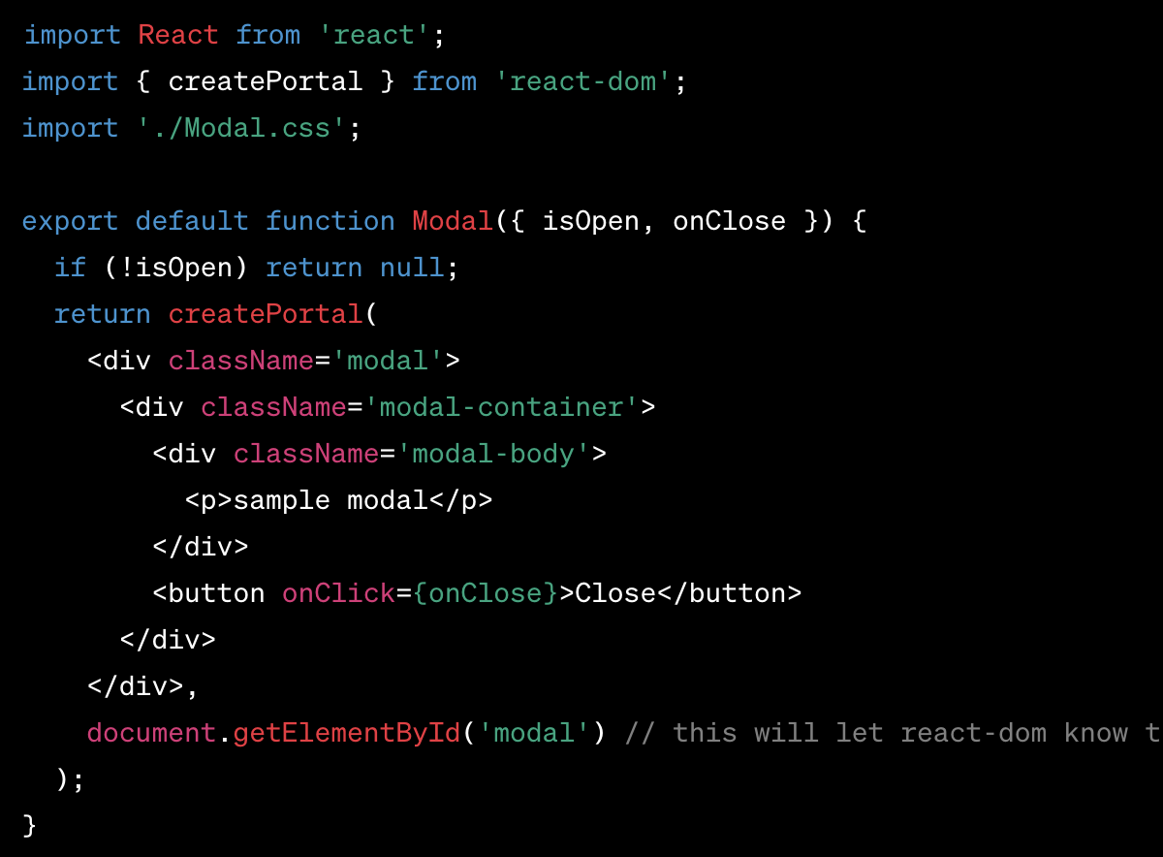
2. Portals

Slide 32
Exercises

Slide 33
3. Fragments

Slide 34
3. Fragments
In React, a Fragment is a lightweight wrapper used to group a list of children without adding extra nodes to the DOM.
React Fragments let you wrap multiple elements and return them from a component without introducing an additional parent element, like a div.
This is particularly useful when the DOM structure matters for styling or is constrained by HTML semantics.

Slide 35
3. Fragments
Fragments are quite useful for a lot of reasons
DOM Cleanliness: Sometimes, wrapping elements in a div or another element can break the styling or be semantically incorrect.
Fragments don't produce any real DOM elements, keeping the DOM cleaner.

Slide 36
3. Fragments
Performance: Using Fragments reduces the number of nodes created in the DOM, which can lead to slight performance improvements, especially in large or deeply nested applications.
Table Elements: They are particularly useful when rendering multiple elements within a table (<tr>, <td>, etc.) where wrapping elements in a div would produce invalid HTML.

Slide 37
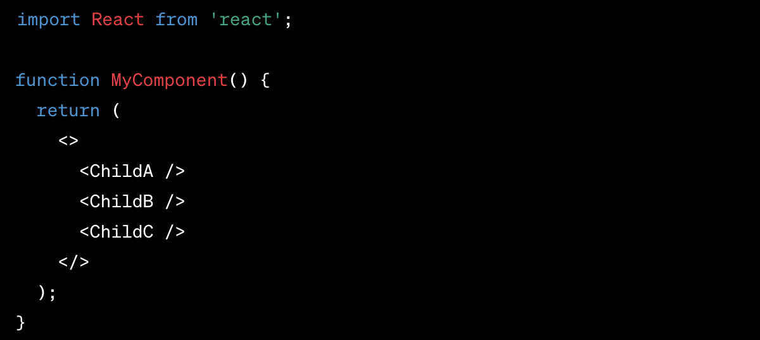
3. Fragments
The most common way to declare a Fragment is the short syntax, which is just an empty tag

Slide 38
3. Fragments
When you need to assign a key to a list of items rendered by a component, you use the explicit <React.Fragment> syntax because the short syntax doesn’t support keys or attributes.

Slide 39
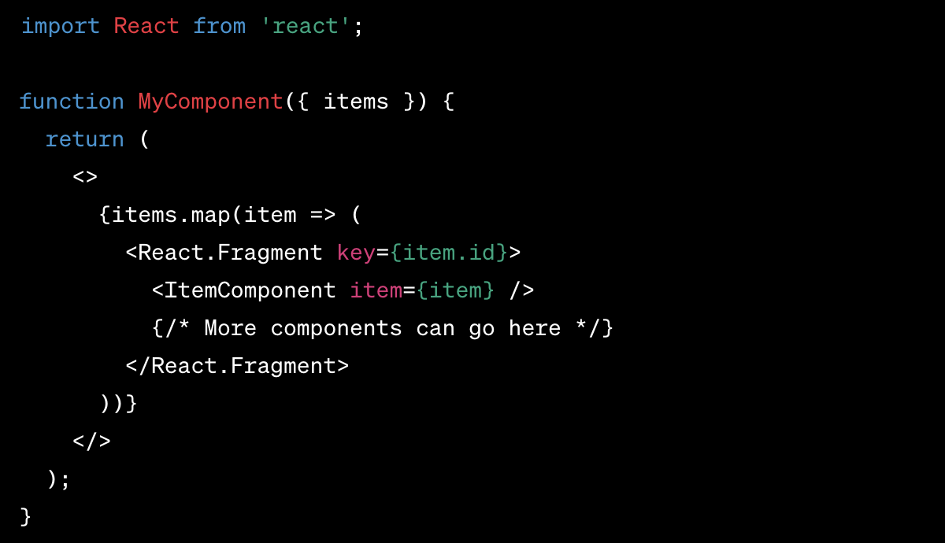
3. Fragments

Slide 40
3. Fragments
While wrapping multiple elements in a div or another HTML element can group them together, doing so adds an extra node to the DOM, which can be unnecessary or undesirable for reasons like styling, performance, or semantic correctness.
Fragments group elements without adding that extra node, making them a more flexible and lightweight solution for component grouping.

Slide 41
3. Fragments
React Fragments are a simple yet powerful tool in React's ecosystem, providing developers with a cleaner and more efficient way to group components and elements without altering the DOM structure unnecessarily.
They maintain the integrity and semantic structure of the HTML while keeping React's component-based architecture elegant and efficient.

Slide 42
Exercises

Slide 43
3. Refs

Slide 44
3. Refs
In React, a "ref" is a short form for "reference," and it provides a way to access DOM nodes or React elements directly.
The primary use of refs is to interact with an element or component outside the typical data flow.
This direct access is useful for managing focus, text selection, media playback, triggering animations, or integrating with third-party DOM libraries.

Slide 45
3. Refs
Refs can be used for specific use case
Managing Focus, Text Selection, or Media Playback: Refs can be used to programmatically manage focus, select text, or control media playback without relying on state or props.

Slide 46
3. Refs
Integrating with Third-Party DOM Libraries: Refs provide a way to pass a DOM node directly to non-React libraries that need direct access to the DOM.
Measuring DOM Node Size and Position: By accessing the DOM node directly, you can use native DOM methods to measure elements or determine their position on the screen.

Slide 47
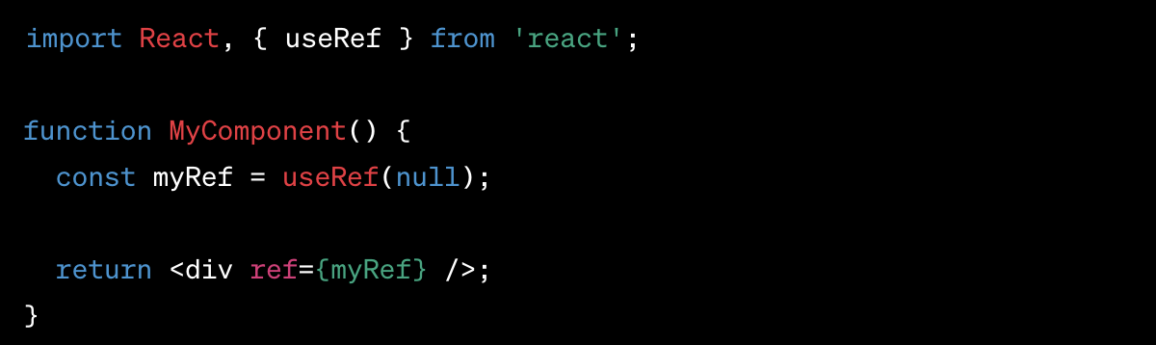
3. Refs
With the introduction of hooks, functional components can also use refs through the useRef() hook.

Slide 48
3. Refs
The current value of a ref is accessed via the .current property of the ref object.
This property will be the DOM element when the ref is attached to a DOM element, and it will be the instance of the mounted React component when the ref is attached to a custom class component.

Slide 49
3. Refs
Refs can also be forwarded to another component via the React.forwardRef API.
This technique is useful when you need a child component to expose its DOM node to a parent component.

Slide 50
3. Refs
While refs are powerful, they should be used sparingly.
Over-reliance on refs can lead to brittle code that's hard to maintain and debug. React's declarative nature usually provides better solutions through state and props.
Refs break this model by allowing for imperative manipulation of the DOM or component instances, which can make your application harder to understand and predict.

Slide 51
3. Refs
Refs in React are a useful feature for directly interacting with DOM nodes or React elements.
They provide an escape hatch from the typical data flow and are essential for tasks that require direct manipulation or access to an element's DOM representation.
However, their use should be limited to cases where declarative solutions aren't feasible, maintaining the purity and predictability of the React data flow.

Slide 52
Exercises

